Slide 1
GEMS Residential & Commercial Loan Programs
STATE OF HAWAII Green Infrastructure Authority |GEMS FINANCING PROGRAM

Slide 2
GEM$ LOAN PROGRAM OVERVIEW

Slide 3
Th
What it is GEM$?
The Green Energy Money $aver (GEM$) On-Bill Program is an innovative financing program for homeowners and renters offered exclusively by the Hawaii Green Infrastructure Authority that features:
No upfront costs
Immediate bill savings
Elimination of credit barriers
Obligation tied to the utility meter (not the person)
Payments conveniently made on your monthly electric bill

Slide 4
Applying for GEM$ is a 2-Step Process
STEP 1: PARTICIPANT ELIGIBILITY
Based on utility bill payment history
No disconnect notice during the past 12 months
STEP 2: PROJECT ELIGIBILITY
Energy Improvement (EI) must be on the Approved EI List
Post-installation, the EI must provide a minimum 10% utility bill savings

Slide 5
APPROVED ENERGY IMPROVEMENT LIST
Residential Installations:
Solar Thermal Water Heaters
Solar PV Water Heaters
Heat Pump Water Heaters
Solar PV Systems
Commercial Installations:
HVAC
Water Heating
Thermal Storage Pumps
Motors
Building Envelope
Refrigeration
Other Commercial Energy Efficiency Technologies
Solar PV Systems

Slide 6
What does 10% savings look like?
Homeowners pre-energy improvement utility bill: $250.00
Post-energy improvement utility bill: $125.00
Monthly GEM$ program charge: $100.00
Total Post-energy improvement installation: $225.00
Monthly Savings: $25
*The 10% savings ensures the homeowner can afford the installed energy improvement and saves money over the useful life of the improvement*

Slide 7
FINANCING PROGRAMS
GEM$-On Bill Repayment Program
No credit evaluation required: Not a loan
Oversized systems NOT allowed
Obligation tied to the utility meter (not a person)
10% immediate bill savings required
Payments conveniently made on your monthly electric utility bill
GEMS - Direct Loan Program
Credit based underwriting to qualify
Oversized systems may be eligible for financing
Loan made directly to customer
20% Savings over the term of the loan (20 years)
Homeowner billed monthly by HGIA
Both programs contribute to the State of Hawaii’s goal to achieve 100% clean energy by 2045 through low cost financing of approved energy improvements
Determine which program is right for your customer!

Slide 8
Next Steps
Homeowner completes a GEM$ financing application or a Direct loan application available on-line
HGIA to apply the two-step process:
Determine if the homeowner is an eligible participant (GEM$) or an eligible borrower (Direct Loan)
Determine if the proposed system meets program eligibility
Once the applicant and proposed system meet eligibility, documents are executed and the Energy Improvement can be installed

Slide 9
New Opportunities with GEM$
Because the GEM$ On-Bill Program obligation is tied to the utility meter and not a person, it is ideal for landlords and renters.
Renter lowers their utility costs without any money out-of-pocket
When a renter moves out, the new renter assumes the obligation on their utility bill and does not have to qualify.
The landlord is given up to 2 years suspension of payments for vacancies during the term of the obligation.
Landlord may be eligible for State & Federal tax credits and depreciation
This creates a WIN-WIN-WIN for the Renter-Landlord - Environment

Slide 10
COMMERCIAL LOAN PROGRAM OVERVIEW

Slide 11
Design of Commercial Loan Products
The design included three objectives:
to collaborate and partner with commercial banks and other financial institutions;
to be more flexible and competitive; and
to fill a market gap with an unconventional financing tool.
Result: Co-lending structure with a capital stack of public & private debt and equity (if required)
Long-term financing tool complements conventional financing and provide low-cost, cash flow friendly capital

Slide 12
Eligible Off Takers (rate payers)
Nonprofits
Small Businesses (as defined by the
U.S. Small Business Administration’s size standards)
For profit multi-family projects

Slide 13
GEM$ FOR COMMERCIAL CUSTOMERS
Qualifying process is the same as the Residential GEM$ program and features the same program benefits
For Energy Efficiency installations, the Contractor must also be a Hawaii Clean Energy Ally and the EE must be on Hawaii Energy’s approved list
For tax purposes, Landlords or Investors are considered “Borrowers” and will undergo traditional underwriting and execute loan documents
With Investor PPAs, the Offtaker has the option to assume the GEM$ debt and purchase the system, thus maximizing their utility savings

Slide 14
Financing Terms
Fixed Interest Rates not to exceed 7.50%
Leverages GEMS funds with Bank financing
Up to 100% Financing – No Money Down
Up to 20 Year Terms
No Prepayment Penalties

Slide 15
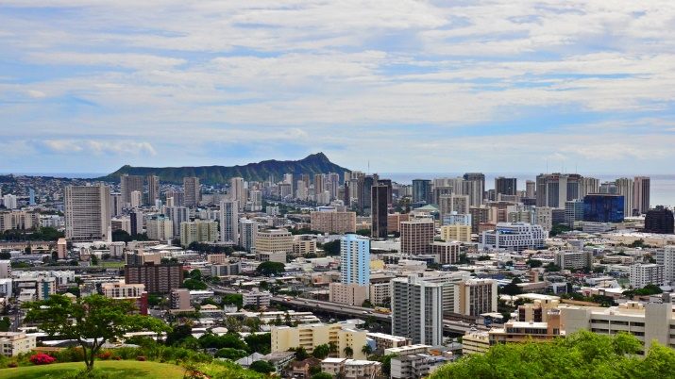
Eligible Properties
Subject Property must be located within the service territories of Hawaiian Electric Company (HECO), Maui Electric Company (MECO) or Hawaii Electric Light Company (HELCO)
The property may be fee simple or leasehold. Leased properties must have at least 20 years remaining on the Lease.

Slide 16
GEMS CONTACTS & RESOURCES

Slide 17
Contact Information
Hawaii Green Infrastructure Authority (HGIA)
Residential Loan Program
Valerie Kubota valerie.c.kubota@hawaii.gov 808-587-2760
Commercial Loan Program
Ryan Hamadon
ryan.r.hamadon@hawaii.gov
808-587-3829

